Slide 1

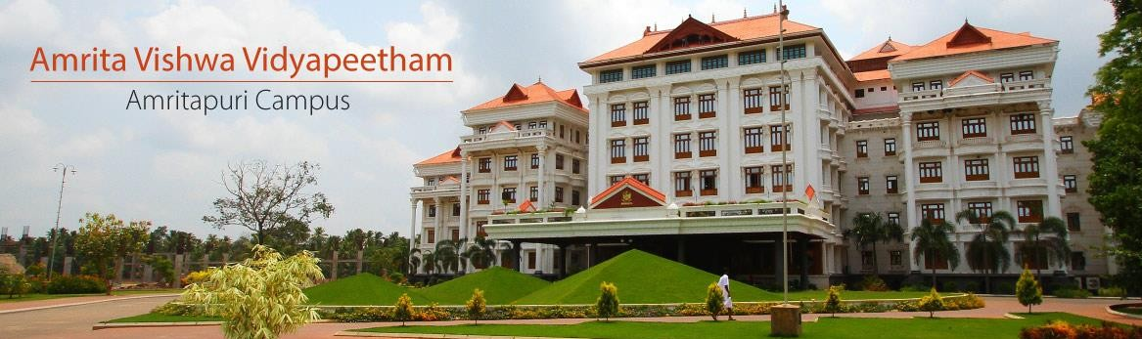
21CSE211 COMPUTER NETWORKS

Slide 2
TRANSPORT LAYER
Chapter 3: Transport Layer
All material copyright 1996-2016
J.F Kurose and K.W. Ross, All Rights Reserved

Slide 3
Chapter 3: Transport Layer
Transport-layer protocols are implemented in the end systems but not in network routers.
On the sending side, the transport layer converts the application layer messages it receives from a sending application process into transport- layer packets, known as transport-layer segments in Internet terminology. This is done by (possibly) breaking the application messages into smaller chunks and adding a transport-layer header to each chunk to create the transport-layer segment. The transport layer then passes the segment to the network layer at the sending end system, where the segment is encapsulated within a network-layer packet (a data gram) and sent to the destination

Slide 4
Transport layer: overview
Our goal:
understand principles behind transport layer services:
multiplexing, demultiplexing
reliable data transfer
learn about Internet transport layer protocols:
UDP: connectionless transport
TCP: connection-oriented reliable transport

Slide 5


















Transport services and protocols
application
transport
network
data link
physical
provide logical communication between application processes running on different hosts
mobile network
national or global ISP
transport protocols actions in end systems:
sender: breaks application messages into segments, passes to network layer
receiver: reassembles segments into messages, passes to application layer
logical end-end transport
local or regional ISP
home network
content
provider
network
application
transport
network
data link
physical
datacenter
network
two transport protocols available to Internet applications
TCP, UDP
enterprise
network
Notes:
By logical communication , we
mean that from an application’s perspective, it is as if the hosts running the processes
were directly connected; in reality, the hosts may be on opposite sides of the
planet, connected via numerous routers and a wide range of link types. Application
processes use the logical communication provided by the transport layer to send
messages to each other, free from the worry of the details of the physical infrastructure
used to carry these messages.
Let’s look at each of these three (logical communications, actions,

Slide 6
Transport vs. network layer services and protocols
household analogy:
transport layer: communication between processes
relies on, enhances, network layer services
12 kids in Ann’s house sending letters to 12 kids in Bill’s house:
hosts = houses
processes = kids
app messages = letters in envelopes
transport protocol = Ann and Bill who demux to in-house siblings
network-layer protocol = postal service
network layer: communication between hosts

Slide 7
Transport Layer Actions
Sender:
application
application
is passed an application-layer message
app. msg
determines segment header fields values
T_{h}
transport
app. msg
transport
T_{h}
creates segment
network (IP)
network (IP)
passes segment to IP
link
link
physical
physical

Slide 8
Transport Layer Actions
Receiver:
application
receives segment from IP
application
checks header values
transport
transport
app. msg
extracts application-layer message
network (IP)
network (IP)
demultiplexes message up to application via socket
link
link
physical
physical
app. msg
T_{h}

Slide 9







































Transport services and protocols
provide logical communication between app processes running on different hosts
transport protocols run in end systems
send side: breaks app messages into segments, passes to network layer
rcv side: reassembles segments into messages, passes to app layer
more than one transport protocol available to apps
Internet: TCP and UDP
application
transport
network
data link
physical
application
transport
network
data link
physical
Transport Layer
3-6

Slide 10
Two principal Internet transport protocols
application
transport
network
data link
physical
TCP: Transmission Control Protocol
reliable, in-order delivery
congestion control
flow control
connection setup
UDP: User Datagram Protocol
unreliable, unordered delivery
no-frills extension of “best-effort” IP
services not available:
delay guarantees
bandwidth guarantees
mobile network
national or global ISP
logical end-end transport
local or regional ISP
home network
content
provider
network
application
transport
network
data link
physical
datacenter
network
enterprise
network

Slide 11
Transport vs. network layer
household analogy:
12 kids in Ann’s house sending letters to 12 kids in Bill’s house:
hosts = houses
processes = kids
app messages = letters in envelopes
transport protocol = Ann and Bill who demux to in- house siblings
network-layer protocol = postal service
Network layer: logical
communication between hosts
Transport layer: logical
communication between
processes
relies on, enhances, network
layer services
If the network-layer protocol cannot provide delay or bandwidth guarantees for transport layer segments sent between hosts, then the transport-layer protocol cannot provide delay or bandwidth guarantees for application messages sent between processes.
A transport protocol can offer reliable data transfer service to an application even when the underlying network protocol is unreliable, eg:transport protocol can use encryption to guarantee that application messages are not read by intruders, even when the network layer cannot guarantee the confidentiality of transport-layer
segments.
Transport Layer
3-7

Slide 12























Internet transport-layer protocols
Reliable, in-order delivery (TCP)
congestion control
flow control
connection setup
Unreliable, unordered delivery: UDP
no-frills extension of “best-effort” IP
services not available:
delay guarantees
bandwidth guarantees
application
transport
network
data link
physical
network data link
network data link physical
physical
network
data link
physical
network
data link
physical
network
data link
network
physical
data link
application
physical
network data link
transport
network
physical
data link
physical
Transport Layer
3-8

Slide 13
Transport-layer Multiplexing/demultiplexing
The most fundamental responsibility of UDP and TCP is to extend IP’s delivery service between two end systems to a delivery service between two processes running on the end systems. Extending host-to-host delivery to process-to- process delivery is called transport-layer multiplexing and demultiplexing.
At the receiving end, the transport layer examines the fields in the segment corresponding to appropriate sockets to identify the receiving socket and then directs the segment to that socket. This job of delivering the data in a transport-layer segment to the correct socket is called demultiplexing. The job of gathering data chunks at the source host from different sockets, encapsulating each data chunk with header information (that will later be used in demultiplexing) to create segments, and passing the segments to the network layer is called multiplexing

Slide 14
Port Address
The IP address identifies the device e.g. computer.
However an IP address alone is not sufficient for running network applications, as a computer can run multiple applications and/or services.
Just as the IP address identifies the computer, The network port identifies the application or service running on the computer.
The use of ports allow computers/devices to run multiple services/applications.
Client port numbers are dynamically assigned, and can be reused once the session is closed.

Slide 15
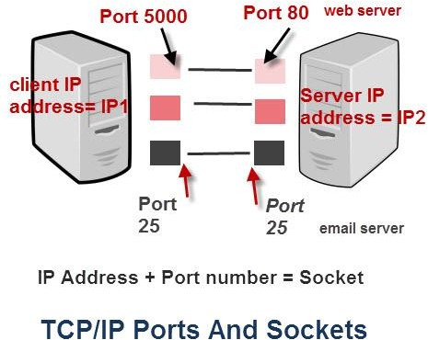
Ports and Sockets
Port Number Ranges and Well Known Ports: A port number uses 16 bits and so can therefore have a value from 0 to 65535 decimal
Sockets :A connection between two computers
uses a socket.
A socket is a software interface between the application layer and the transport layer, Using a metaphor, the process is analogous to a house and a socket to its door.
A socket is the combination of IP address plus
port
Analogy
If you use a house or apartment block analogy the IP address corresponds to the street address. All of the apartments share the same street address.
However each apartment also has an apartment number which corresponds to the Port number.

Slide 16
Types of Port numbers
Port numbers are divided into ranges as follows:
Port numbers 0-1023 – Well known ports. These are allocated to server services by the Internet Assigned Numbers Authority (IANA). e.g Web servers normally use port 80 and SMTP servers use port 25 (see diagram above).
Ports 1024-49151- Registered Port -These can be registered for services with
the IANA and should be treated as semi-reserved. Registered port numbers are non– well-known ports that are used by vendors for their own server applications.
Ports 49152-65535– These are used by client programs and you are free to use these in client programs. When a Web browser connects to a web server the browser will allocate itself a port in this range. Also known as ephemeral ports.

Slide 17

Multiplexing/demultiplexing
multiplexing as sender:
demultiplexing as receiver:
handle data from multiple
sockets, add transport header (later used for demultiplexing)
use header info to deliver
received segments to correct
socket
application
application
P1
P2
application
socket
P3
transport
P4
process
transport
network
transport
network
link
network
link
physical
link
physical
physical

Slide 18




HTTP server
client
application
application
HTTP msg
transport
H_{t}
HTTP msg
H_{n}
H_{t}
network
transport
HTTP msg
transport
H_{n}
H_{t}
link
network
network
HTTP msg
link
physical
link
physical
physical
H_{n}
H_{t}
HTTP msg

Slide 19

Q: how did transport layer know to deliver message to Firefox browser process rather then Netflix process or Skype process?
client
application
application
HTTP msg
HTTP msg
transport
H_{t}
HTTP msg
transport
network
transport
network
link
network
link
physical
link
physical
physical

Slide 20
?
de-multiplexing

Slide 21
application
?
transport
de-multiplexing

Slide 22
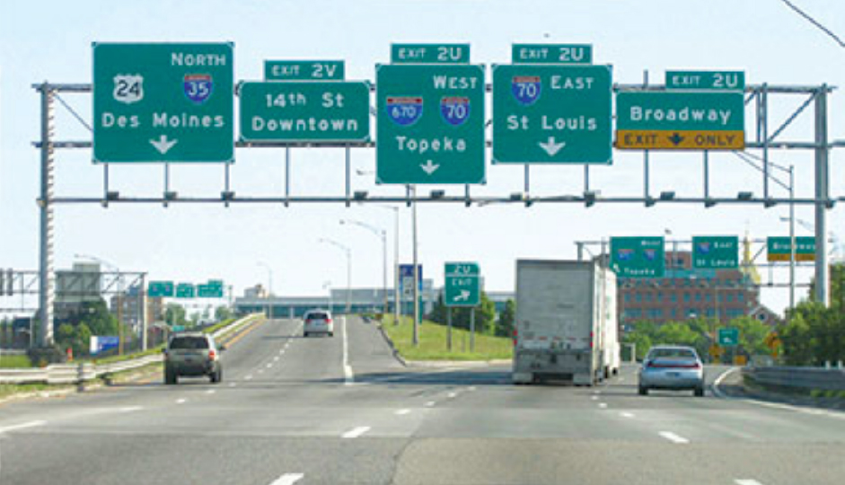
Demultiplexing

Slide 23
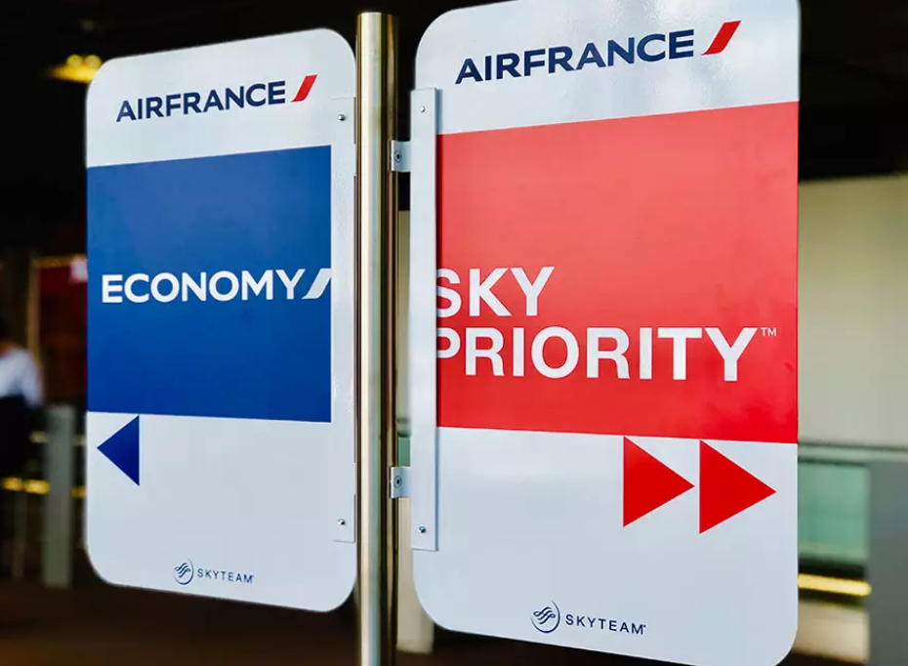

Slide 24
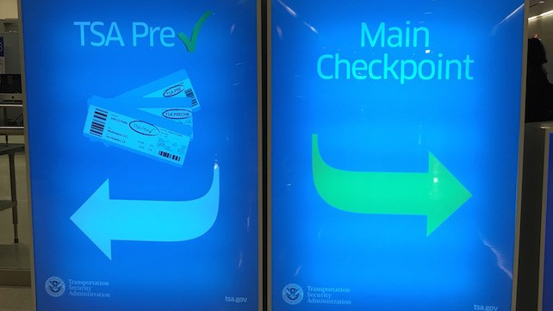

Slide 25
multiplexing

Slide 26
application
transport
multiplexing

Slide 27
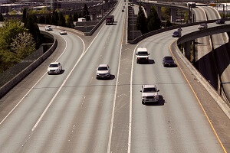
Multiplexing

Slide 28
How demultiplexing works
host receives IP datagrams
each datagram has source IP address, destination IP address
each datagram carries one transport-layer segment
each segment has source, destination port number
host uses IP addresses & port numbers to direct segment to appropriate socket
32 bits
source port #
dest port #
other header fields
application
data
(payload)
TCP/UDP segment format

Slide 29
Connectionless demultiplexing
Recall:
when creating socket, must specify host-local port #:
DatagramSocket mySocket1 = new DatagramSocket(12534);
when receiving host receives UDP segment:
checks destination port # in segment
directs UDP segment to socket with that port #
when creating datagram to send into UDP socket, must specify
destination IP address
destination port #
IP/UDP datagrams with same dest. port #, but different source IP addresses and/or source port numbers will be directed to same socket at receiving host

Slide 30
Connectionless demultiplexing: an example
mySocket = socket(AF_INET,SOCK_DGRAM)
mySocket.bind(myaddr,6428);
mySocket = socket(AF_INET,SOCK_STREAM)
mySocket.bind(myaddr,9157);
mySocket = socket(AF_INET,SOCK_STREAM)
mySocket.bind(myaddr,5775);
application
application
P1
application
P3
P4
transport
transport
network
transport
network
link
network
link
physical
link
physical
physical
B
D
source port: 6428
dest port: 9157
source port: ?
dest port: ?
A
C
source port: 9157
dest port: 6428
source port: ?
dest port: ?

Slide 31
Connection-oriented demultiplexing
TCP socket identified by 4-tuple:
source IP address
source port number
dest IP address
dest port number
server may support many simultaneous TCP sockets:
each socket identified by its own 4-tuple
each socket associated with a different connecting client
demux: receiver uses all four values (4-tuple) to direct segment to appropriate socket

Slide 32

Connection-oriented demultiplexing: example
application
application
P4
P5
P6
application
P1
P2
P3
transport
transport
network
transport
network
link
network
link
physical
link
physical
server: IP address B
physical
host: IP address A
source IP,port: B,80
dest IP,port: A,9157
host: IP address C
source IP,port: C,5775
dest IP,port: B,80
source IP,port: A,9157
dest IP, port: B,80
source IP,port: C,9157
dest IP,port: B,80
Three segments, all destined to IP address: B,
dest port: 80 are demultiplexed to different sockets

Slide 33
Summary
Multiplexing, demultiplexing: based on segment, datagram header field values
UDP: demultiplexing using destination port number (only)
TCP: demultiplexing using 4-tuple: source and destination IP addresses, and port numbers
Multiplexing/demultiplexing happen at all layers

Slide 34
UDP: User Datagram Protocol [RFC 768]
If the application developer chooses UDP instead of TCP, then the application is almost directly talking with IP.of network layer. UDP takes messages from the application process, attaches source and destination port number fields for the multiplexing/demultiplexing service, adds two other small fields, and passes the resulting segment to the network layer. The network layer encapsulates the transport-layer segment into an IP datagram and then makes a best-effort attempt to deliver the segment to the receiving host. If the segment arrives at the receiving host, UDP uses the destination port number to deliver the segment’s data to the correct
application process
UDP there is no handshaking between sending and receiving transport-layer entities before sending a segment. For this reason, UDP is said to be connectionless.
DNS is an example of an application-layer protocol that typically uses UDP. When the DNS application in a host wants to make a query, it constructs a DNS query message and passes the message to UDP. Without performing any handshaking with the UDP entity running on the destination end system, the host-side UDP
adds header fields to the message and passes the resulting segment to the network layer.

Slide 35
Isn’t TCP always preferable, since TCP provides a reliable data transfer service, while UDP does not?
The answer is no, as many applications are better suited for UDP for the following reasons:
Finer application-level control over what data is sent, and when: Since real-time applications often require a minimum sending rate, do not want to overly delay segment transmission, and can tolerate some data loss,TCP’s service model is not particularly well matched to these applications’ needs. (EG: streaming multimedia)
No connection establishment. TCP uses a three-way handshake before it starts to transfer data. UDP just blasts away without any formal preliminaries. Thus UDP does not introduce any delay to establish a connection. This is probably the principal reason why DNS runs over UDP rather than TCP—DNS would be much slower if it ran over TCP. HTTP uses TCP rather than UDP since reliability is critical for Web pages with text
No connection state. TCP maintains a connection state in the end systems. This connection state includes receive and send buffers, congestion-control parameters, and sequence and acknowledgment number parameters.UDP, on the other hand, does not maintain a connection state and does not track any of these parameters. For this reason, a server devoted to a particular application can typically support many more active clients when the application runs over UDP rather than TCP.
Small packet header overhead. The TCP segment has 20 bytes of header overhead in every segment, whereas
UDP has only 8 bytes of overhead.

Slide 37
UDP: User Datagram Protocol [RFC 768]
“no frills,” “bare bones” Internet transport protocol
“best effort” service, UDP segments may be:
lost
delivered out-of-order to app
connectionless:
no handshaking between UDP
sender, receiver
each UDP segment handled independently of others
UDP use:
streaming multimedia apps (loss tolerant, rate sensitive)
DNS
SNMP
reliable transfer over UDP:
add reliability at
application layer
application-specific error recovery!
Transport Layer
3-25

Slide 38
UDP: User Datagram Protocol
Why is there a UDP?
“no frills,” “bare bones” Internet transport protocol
“best effort” service, UDP segments may be:
lost
delivered out-of-order to app
no connection establishment (which can add RTT delay)
simple: no connection state at sender, receiver
small header size
no congestion control
UDP can blast away as fast as desired!
can function in the face of congestion
connectionless:
no handshaking between UDP sender, receiver
each UDP segment handled independently of others

Slide 39
UDP: User Datagram Protocol
UDP use:
streaming multimedia apps (loss tolerant, rate sensitive)
DNS
SNMP
HTTP/3
if reliable transfer needed over UDP (e.g., HTTP/3):
add needed reliability at application layer
add congestion control at application layer

Slide 40
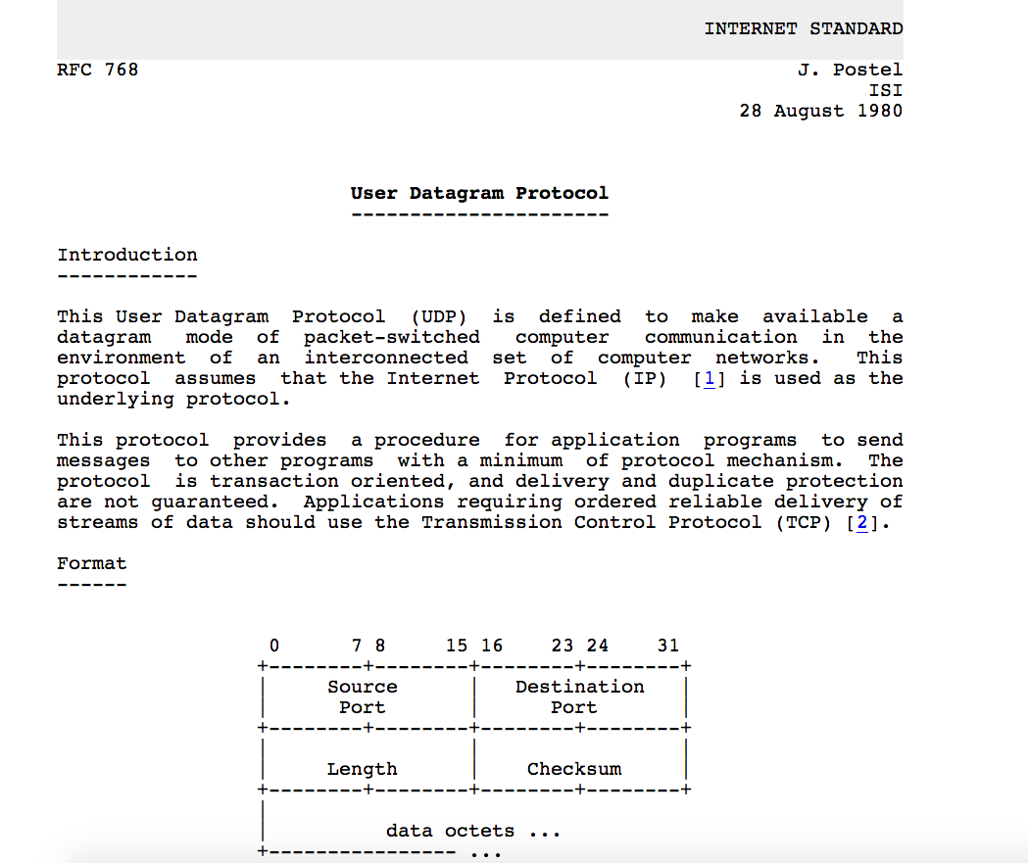
UDP: User Datagram Protocol [RFC 768]
Notes:
read this RFC – it’s only 2.5 pages!

Slide 41
UDP: Transport Layer Actions
SNMP client
SNMP server
application
application
transport
(UDP)
transport
(UDP)
network (IP)
network (IP)
link
link
physical
physical

Slide 42
UDP: Transport Layer Actions
SNMP client
SNMP server
UDP sender actions:
application
application
is passed an application-layer message
SNMP msg
transport
(UDP)
transport
(UDP)
determines UDP segment header fields values
UDP_{h}
SNMP msg
UDP_{h}
creates UDP segment
network (IP)
network (IP)
passes segment to IP
link
link
physical
physical

Slide 43
UDP: Transport Layer Actions
SNMP client
SNMP server
UDP receiver actions:
application
receives segment from IP
application
checks UDP checksum header value
transport
(UDP)
transport
(UDP)
SNMP msg
extracts application-layer message
network (IP)
network (IP)
SNMP msg
UDP_{h}
demultiplexes message up to application via socket
link
link
physical
physical

Slide 44
UDP segment header
32 bits
source port #
dest port #
length
checksum
application
data
(payload)
length, in bytes of UDP segment, including header
data to/from application layer
UDP segment format

Slide 45

UDP checksum
Goal: detect errors (i.e., flipped bits) in transmitted segment
1st number
2nd number
sum
Transmitted: 5 6 11
Received: 4 6 11
receiver-computed
checksum
=
sender-computed
checksum (as received)

Slide 46
Internet checksum
Goal: detect errors (i.e., flipped bits) in transmitted segment
sender:
treat contents of UDP segment (including UDP header fields and IP addresses) as sequence of 16-bit integers
checksum: addition (one’s complement sum) of segment content
checksum value put into UDP checksum field
receiver:
compute checksum of received segment
check if computed checksum equals checksum field value:
not equal - error detected
equal - no error detected. But maybe errors nonetheless? More later ….

Slide 47
Internet checksum: an example
example: add two 16-bit integers
1 1 1 0 0 1 1 0 0 1 1 0 0 1 1 0
1 1 0 1 0 1 0 1 0 1 0 1 0 1 0 1
wraparound
1 1 0 1 1 1 0 1 1 1 0 1 1 1 0 1 1
sum
1 0 1 1 1 0 1 1 1 0 1 1 1 1 0 0
checksum
0 1 0 0 0 1 0 0 0 1 0 0 0 0 1 1
Note: when adding numbers, a carryout from the most significant bit needs to be added to the result
* Check out the online interactive exercises for more examples: http://gaia.cs.umass.edu/kurose_ross/interactive/

Slide 48
Internet checksum: weak protection!
example: add two 16-bit integers
0 1
1 1 1 0 0 1 1 0 0 1 1 0 0 1 1 0
1 0
1 1 0 1 0 1 0 1 0 1 0 1 0 1 0 1
wraparound
1 1 0 1 1 1 0 1 1 1 0 1 1 1 0 1 1
Even though numbers have changed (bit flips), no change in checksum!
sum
1 0 1 1 1 0 1 1 1 0 1 1 1 1 0 0
checksum
0 1 0 0 0 1 0 0 0 1 0 0 0 0 1 1

Slide 49
Summary: UDP
“no frills” protocol:
segments may be lost, delivered out of order
best effort service: “send and hope for the best”
UDP has its plusses:
no setup/handshaking needed (no RTT incurred)
can function when network service is compromised
helps with reliability (checksum)
build additional functionality on top of UDP in application layer (e.g., HTTP/3)

Slide 50
Thank you

